Slide 1

Department of Computer Engineering Data Science and Machine Learning P

Slide 2




Expressions
Combination of Operators and Operands
Operators
2 * y + 5
Example
Operands

Slide 3

OPERATORS
Definition
“An operator is a symbol (+,-,*,/) that directs the computer to perform certain mathematical or logical manipulations and is usually used to manipulate data and variables”
Ex: a+b

Slide 4

Operators in Prog.
Arithmetic operators
Relational operators
Logical operators
Assignment operators
Increment and decrement operators
Conditional operators
Bitwise operators
Special operators

Slide 5
Arithmetic Operators
These are used to perform arithmetic operations. All of these can be used as binary operators. These are :
add
- subtract
* multiply
divide( divisor must be non zero ) modulo(gives remainder after div)
+
/
%
The operators + and - cab be used as unary plus and unary minus arithmetic operators also. The unary – negates the sign of it’s operand .

Slide 6

Arithmetic operators
Operator | example | Meaning
+ | a + b | Addition –unary
- | a – b | Subtraction- unary
* | a * b | Multiplication
/ | a / b | Division
% | a % b | Modulo division- remainder

Slide 7
Following are some examples of arithmetic operators :
x+y, x-y, x*y, x/y, x%y , -x*y Here x and y are operands.
The % operator cannot be used on floating point data type.

Slide 8
Arithmetic Expressions
An expression consisting of numerical values(either any number, variable or even some function call) joined together by arithmetic operators is known as an arithmetic expression. For example , consider the following expression :
(x-y)*(x+y)/5
Here x , y and 5 are operands and the symbols -,*,+,/ are operators.
The precedence of operators for the expression evaluation has been given by using parenthesis which will over rule the operators precedence. If x=25 and y=15,then the value of this expression will be 80.

Slide 9
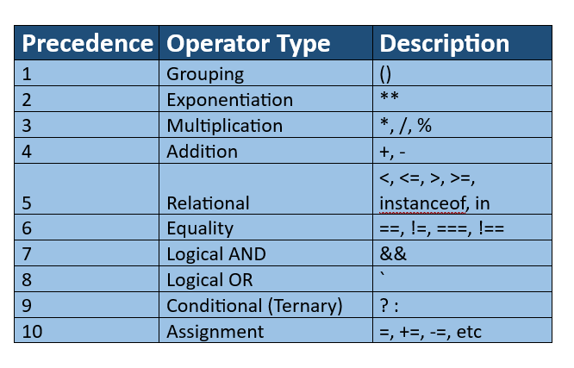

Slide 10
Arithmetic Expressions
Consider the following expression :
3*((i%4)*(5+(j-2)/(k+3)))
Where i,j,k are integer variables. If i,j ,k have values 9 ,14 ,6 respectively then above expression would be evaluated as
3 * ((9%4) * (5 + (14 – 2) / (6 +3 )))
= 3 * ( 1 * (5 + (12 / 9) ) )
= 3 * ( 1 * (5 + 1))
= 3 * ( 1 * 6 )
= 3 * 6
= 18

Slide 11
Questions
[36 ÷ (-9)] ÷ [(-24) ÷ 6]
46*2+(46-42)*4
[91+46(76*3)*(47-2)+(41+41)]
X=A+B-C*D/E
A=2
B=3
C=4
D=1
E=6
5. (8×3+4)−(10/2)×2+(15%7)
6. 3a2+(b−4c)​×(e5d​+f​)−(hg2​−(i×j))

Slide 12
Ans 1:- 1
Ans 2:- 108
Ans3:- 472133
Ans4:- 4.333
Ans5:- 19

Slide 13
Identify the type of following literals:-
23.789
23789
True
‘True’
“True”
False
‘ “False” ‘
“39.87”
“Hello90.3”
766.23E

Slide 14
1.”This Course is great”
2.’She Shouted “Hellow” very loudly”
3.”Goodbye’
4.”Hello”
5.’I liked the movie ‘ABCD’ very much.”

Slide 15
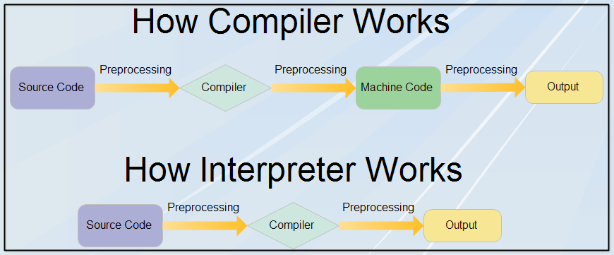
Compiler: A compiler translates code from a high-level programming language (like Python, JavaScript or Go) into machine code before the program runs.
Interpreter: An interpreter translates code written in a high-level programming language into machine code line-by-line as the code runs.

Slide 16
Modes of Expression
We can have an arithmetic statement of the following types :
(i) Integer mode arithmetic statement (ii)Real mode arithmetic statement (iii)Mixed mode arithmetic statement

Slide 17
Integer mode arithmetic statement
It consist of all operands as either integer constants or integer variables. For example ,
int s, y, I, j, result ; x=50;
y=x+10; i=2;
j=i*3;
result=x / 7 – y % j + I ;
In case of integer division, result is truncated towards zero when both the operands are of the same sign. When one of the operands is negative the truncation depends upon the implementation. For example :

Slide 18
Integer mode arithmetic statement
3/5 = 0 and -3/-5 =0
But -3/5 can result into 0 or -1 (it is machine dependent)
For modulo division , the sign of result is always that of the first operand or dividend. For example,
13 % - 5 = 3
- 13 % - 5 = - 3
- 13 % 5 = - 3

Slide 19
Real mode arithmetic statement
It consist of all operands as either real variables or real constants
For example,
float a,b,d; a=5.0;
b=a*20.5;
d=a / 2.0 * b – 10.0;
In PL, real operand may store value in either of the two forms i.e., in fractional form or exponential form. We cannot use % operator with real operands.

Slide 20
Mixed mode arithmetic statement
When one of the operand is real and the other is integer, the expression is called Mixed Mode Arithmetic Expression.
If either operand is of real type, then only the real operation is
performed and the result is always a real number. Thus:
15/10.0=1.5
Whereas
15/10=1

Slide 21
Relational Operators
These are used to compare two variables or constants . PL has the following relational operators :
Operator | Meaning
< | Is less than
<= | Is less than or equal to
> | Is greater than
>= | Is greater than or equal to
== | Equal to
!= | Not equal to

Slide 22

Logical Operators
Operator | Meaning
&& | Logical AND
|| | Logical OR
! | Logical NOT
Logical expression or a compound relational expression-
An expression that combines two or more
relational expressions
Ex: if (a==b && b==c)

Slide 23

Truth Table
a | b | Value of the expression
 |  | a && b | a || b
0 | 0 | 0 | 0
0 | 1 | 0 | 1
1 | 0 | 0 | 1
1 | 1 | 1 | 1

Slide 24
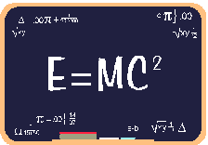
Assignment operators
It is used to assign the result of an expression to variable.
Syntax:
v op = exp; Where v = variable,
op = shorthand assignment operator exp = expression
Ex: x=x+3
x+=3

Slide 25

Shorthand Assignment operators
Simple assignment operator | Shorthand operator
a = a+1 | a + =1
a = a-1 | a - =1
a = a* (m+n) | a * = m+n
a = a / (m+n) | a / = m+n
a = a %b | a %=b

Slide 26

Increment & Decrement Operators
PL supports 2 useful operators namely
Increment ++
Decrement – operators
The ++ operator adds a value 1 to the operand The – operator subtracts 1 from the operand
++a or a++
--a or a--

Slide 27

Rules for ++ & -- operators
These require variables as their operands
When postfix either ++ or – is used with the variable in a given expression, the expression is evaluated first and then it is incremented or decremented by one
When prefix either ++ or – is used with the variable in a given expression, it is incremented or decremented by one first and then the expression is evaluated with the new value

Slide 28

Examples for ++ & -- operators
Let the value of a =5 and b=++a then a = b =6
Let the value of a = 5 and b=a++ then a =5 but b=6
i.e.:
a prefix operator first adds 1 to the operand and then the result is assigned to the variable on the left
a postfix operator first assigns the value to the variable on left and then increments the operand.

Slide 29

Conditional operators(Ternary Operator)
Syntax:
exp1 ? exp2 : exp3
Where exp1,exp2 and exp3 are expressions Working of the ? Operator:
Exp1 is evaluated first, if it is nonzero(1/true) then the expression2 is
evaluated and this becomes the value of the expression,
If exp1 is false(0/zero) exp3 is evaluated and its value becomes the value of the expression
Ex: m=2;
n=3
r=(m>n) ? m : n;

Slide 30

Bitwise operators
These operators allow manipulation of data at the bit level
Operator | Meaning
& | Bitwise AND
| | Bitwise OR
^ | Bitwise exclusive OR
<< | Shift left
>> | Shift right

Slide 31

Special operators
Comma operator ( ,)
sizeof operator – sizeof( )
Pointer operators – ( & and *)
Member selection operators – ( . and ->)

Slide 32
Arithmetic Expressions
Algebraic expression | PL expression
axb-c | a*b-c
(m+n)(x+y) | (m+n)*(x+y)
ab c | a*b/c
3x²+2x+1 | 3*x*x+2*x+1
a b | a/b
_{S=} a + b + c 2 | S=(a+b+c)/2

Slide 33
Arithmetic Expressions
Algebraic expression |  | PL expression
area= | s(s − a)(s − | area=sqrt(s*(s-a)*(s-b)*(s-c))
Sin ⎛ ^{b} ⎜ ⎝ |  | sin(b/sqrt(a*a+b*b))
τ₁ = | ^{⎧σx −σ y ⎫} +τxy² ⎨ ₂ ⎬ ⎩ ⎭ | tow1=sqrt((rowx-rowy)/2+tow*x*y*y)
τ₁ = | ⎧σ −σ ⎫² ⎨ ^{x y} ⎬ +τxy² ⎩ ² ⎭ | tow1=sqrt(pow((rowx-rowy)/2,2)+tow*x*y*y)
y = ^{α + β} + x sinθ |  | y=(alpha+beta)/sin(theta*3.1416/180)+abs(x)

Slide 34
Precedence of operators
BODMAS RULE-
Brackets of Division Multiplication Addition Subtraction Brackets will have the highest precedence and have to be evaluated first, then comes of , then comes
division, multiplication, addition and finally subtraction.
Programming language uses some rules in evaluating the expressions
and they r called as precedence rules or sometimes also referred to as hierarchy of operations, with some operators with highest precedence and some with least.
The 2 distinct priority levels of arithmetic operators in c are- Highest priority : * / %
Lowest priority : + -

Slide 35
Rules for evaluation of expression
First parenthesized sub expression from left to right are evaluated.
If parentheses are nested, the evaluation begins with the innermost sub expression
The precedence rule is applied in determining the order of application of operators in evaluating sub expressions
The associatively rule is applied when 2 or more operators of the same precedence level appear in a sub expression.
Arithmetic expressions are evaluated from left to right using the rules of precedence
When parentheses are used, the expressions within parentheses
assume highest priority

Slide 36
The Associativity of Operators
The operators having the equal precedence are evaluated either from left to right or from right to left, depending on the level. It is known as associativity property of the operator.

Slide 37
Hierarchy of operators
Operator | Description | Associativity
( ), [ ] | Function call, array element reference | Left to Right
+, -, ++, - - ,!,~,*,& | Unary plus, minus, increment, decrement, logical negation, 1’s complement, pointer reference, address | Right to Left
*, / , % | Multiplication, division, modulus | Left to Right

Slide 38
Example 1
Evaluate x1=(-b+ sqrt (b*b-4*a*c))/(2*a) @ a=1, b=-5, c=6
=(-(-5)+sqrt((-5)(-5)-4*1*6))/(2*1)
=(5 + sqrt((-5)(-5)-4*1*6))/(2*1)
=(5 + sqrt(25 -4*1*6))/(2*1)
=(5 + sqrt(25 -4*6))/(2*1)
=(5 + sqrt(25 -24))/(2*1)
=(5 + sqrt(1))/(2*1)
=(5 + 1.0)/(2*1)
=(6.0)/(2*1)
=6.0/2 = 3.0

Slide 39
Example 2
Evaluate the expression when a=4
b=a- ++a
=a – 5
=5-5
=0

Slide 40




